Slide 1
Text Detection and Localization in Natural
Images
Dushyant Jangra(2016035)
&
Harshit Anand(2016042)

Slide 2
Problem statement
To Detect textual regions and localize the Information present in the natural images using a texture based method.
In particular, any text present in the image.

Slide 3
Approaches
Over the past years, so many algorithms are published. Mainly All the algorithms can be classified into three categories:
Connected Component Based Detection
Edge Based Detection
Texture Based Detection

Slide 4
Why Texture Based Method?
Out of the three methods, we preferred Text Based method due to following reasons:
As the texture features don’t capture any language dependent features, the Texture Based method is language independent.
The Edge method and connected component method gives poor results when applied to Indian languages.

Slide 5
Work Flow
Texture Based Method Block Diagram
F(x,y)
Background removal/suppression in the DCT domain
G(x,y)
Features Extraction
Classification
Merging of text blocks into text regions
Refinement of identified text regions
Text regions

Slide 6
Texture Based Method
Background removal/suppression in the DCT domain
Suppress the background from the image by Dividing the image into 8x8 blocks.
Apply DCT for every 8x8 block and suppress the background using high pass filter.
Obtain processed image by performing inverse DCT on every 8x8
block
DCT on
every8x8
block
G(u,v)
H (u, v)
High pass
filter
P(u,v)
Inverse
DCT on
P(u,v)
G(x,y)
F(x,y)
Figure 2: High Pass Filter for Background Removal using DCT
Where,
G(u,v) is DCT matrix of input image f(x,y).
P(u,v) is Processed DCT matrix.
g(x,y) is background suppressed image.

Slide 7
Features Extraction
Extract the texture features like homogeneity and contrast for each block in all four orientations 0, 45, 90and 135 degrees
D = [ X1, X2, X3…………………… XN] T is a 50*50 block
Xi = [rmin, rmax, cmin, cmax, f1,f2,f3,f4,f5,f6,f7,f8]
f1,f3,f5,f7 are Homogeneity at 0,45,90,135 degree orientations
f2,f4,f6,f8 are Contrast at 0,45,90,135 degree orientations
Q Q
Homogeneity = ∑ ∑ ( P(i,j)/R)²
i=1 j=1
Q-1 Q
Contrast = ∑ n2 ∑ ( P(i,j) /R)
n=1 |i-j|=n
P corresponds to cooccurrence matrix at a given degree.
R is normalized value of cooccurrence matrix P.
N is total number of blocks.
QxQ is dimension of block size which is chosen as 50x50.

Slide 8
The blocks, having lesser homogenity and higher contrast are possible text blocks
Class w1 if d1(Xi) is satisfied, and d2(Xi) is satisfied
Class w2 otherwise
Where,
d1(Xi) is a discriminant function which defines/specifies constraint on homogeneity value.
d2(Xi) is a discriminant function which defines/specifies constraint on Contrast value.
d1(Xi)= satisfied if Xi (fj) <= T1, ∀ i=1, N and j = 1,3,5,7
Not satisfied otherwise
d2(Xi)= satisfied if Xi(fj) >=T2 ∀ i=1,N and ,j = 2,4,6,8 (11)
Not satisfied otherwise
Where,
T1 corresponds to threshold on homogeneity (T1 = 0.4), chosen empirically.
T2 corresponds to threshold on contrast T2 = (50), chosen empirically.
Classification

Slide 9
Merging of text blocks
Merging the adjacent text blocks (to a bigger rectangular block)
Algorithm:
Input: Vector B which contains coordinates of identified text
blocks
Output: Vector R which records text regions
Begin
1. Choose the first block Cs from vector B.
2. Initialize coordinates of a new text region ri to coordinates of
block Cs.
3. Select next block Cp from the vector B.
4. if (the block Cp is connected to ri in row or column) then
begin
Merge and update coordinates rmin, rmax, cmin, cmax of block ri.
rmin = min{ ri [rmin ], Cp[rmin] } rmax = max{ ri [rmax ], Cp[rmax] }
cmin = min{ ri [cmin ], Cp[cmin] } cmax = max{ ri [cmax ], Cp[cmax] }
else
Store text region ri into vector R.
Initialize coordinates of a new text region ri to coordinates of
current block Cp.
end
5. Repeat steps 2 -5 until p=N1.

Slide 10
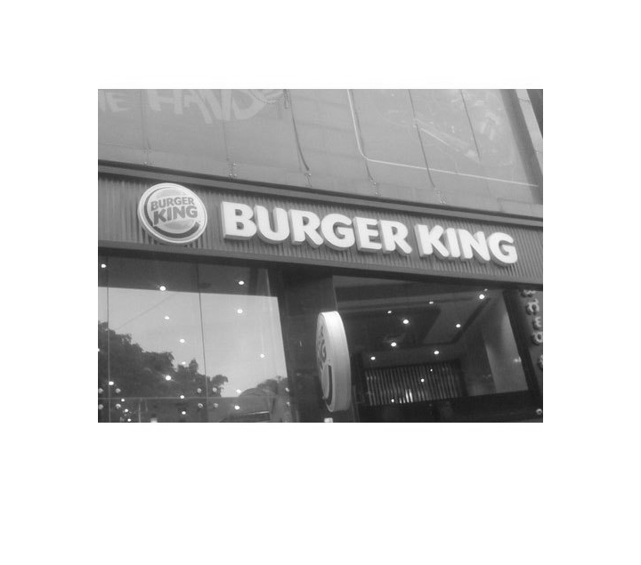
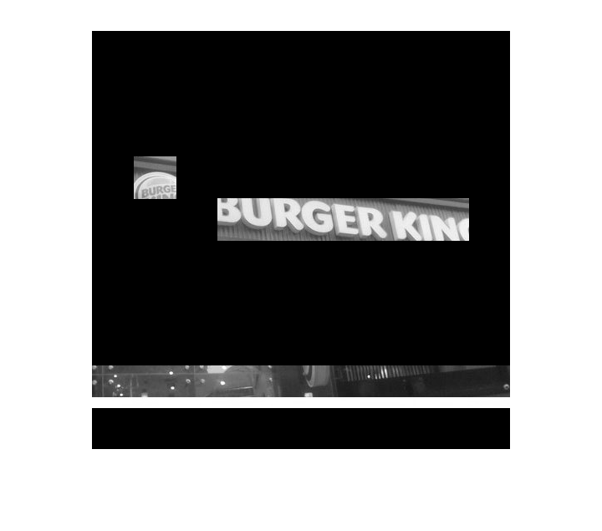

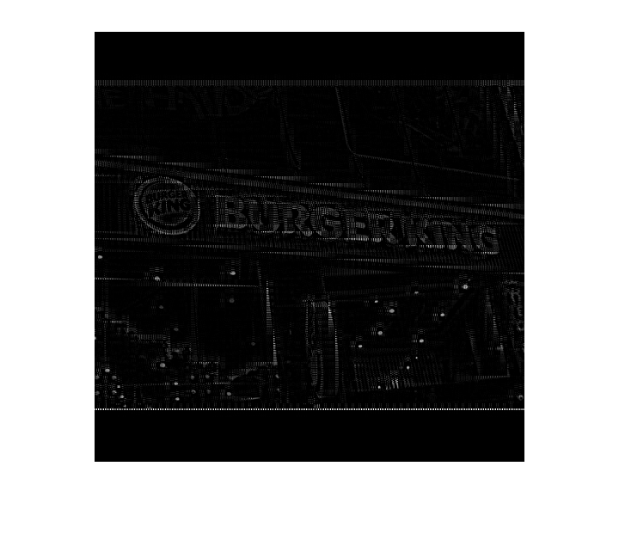
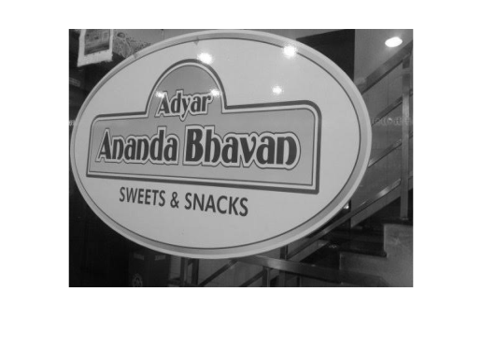


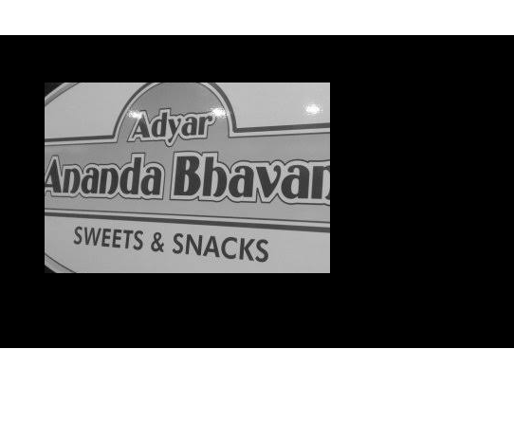
RESULTS

Slide 11
Applications
Key word based Image search
Automatic Video Logging
Automatic Text-based Image Indexing

